Slide 1
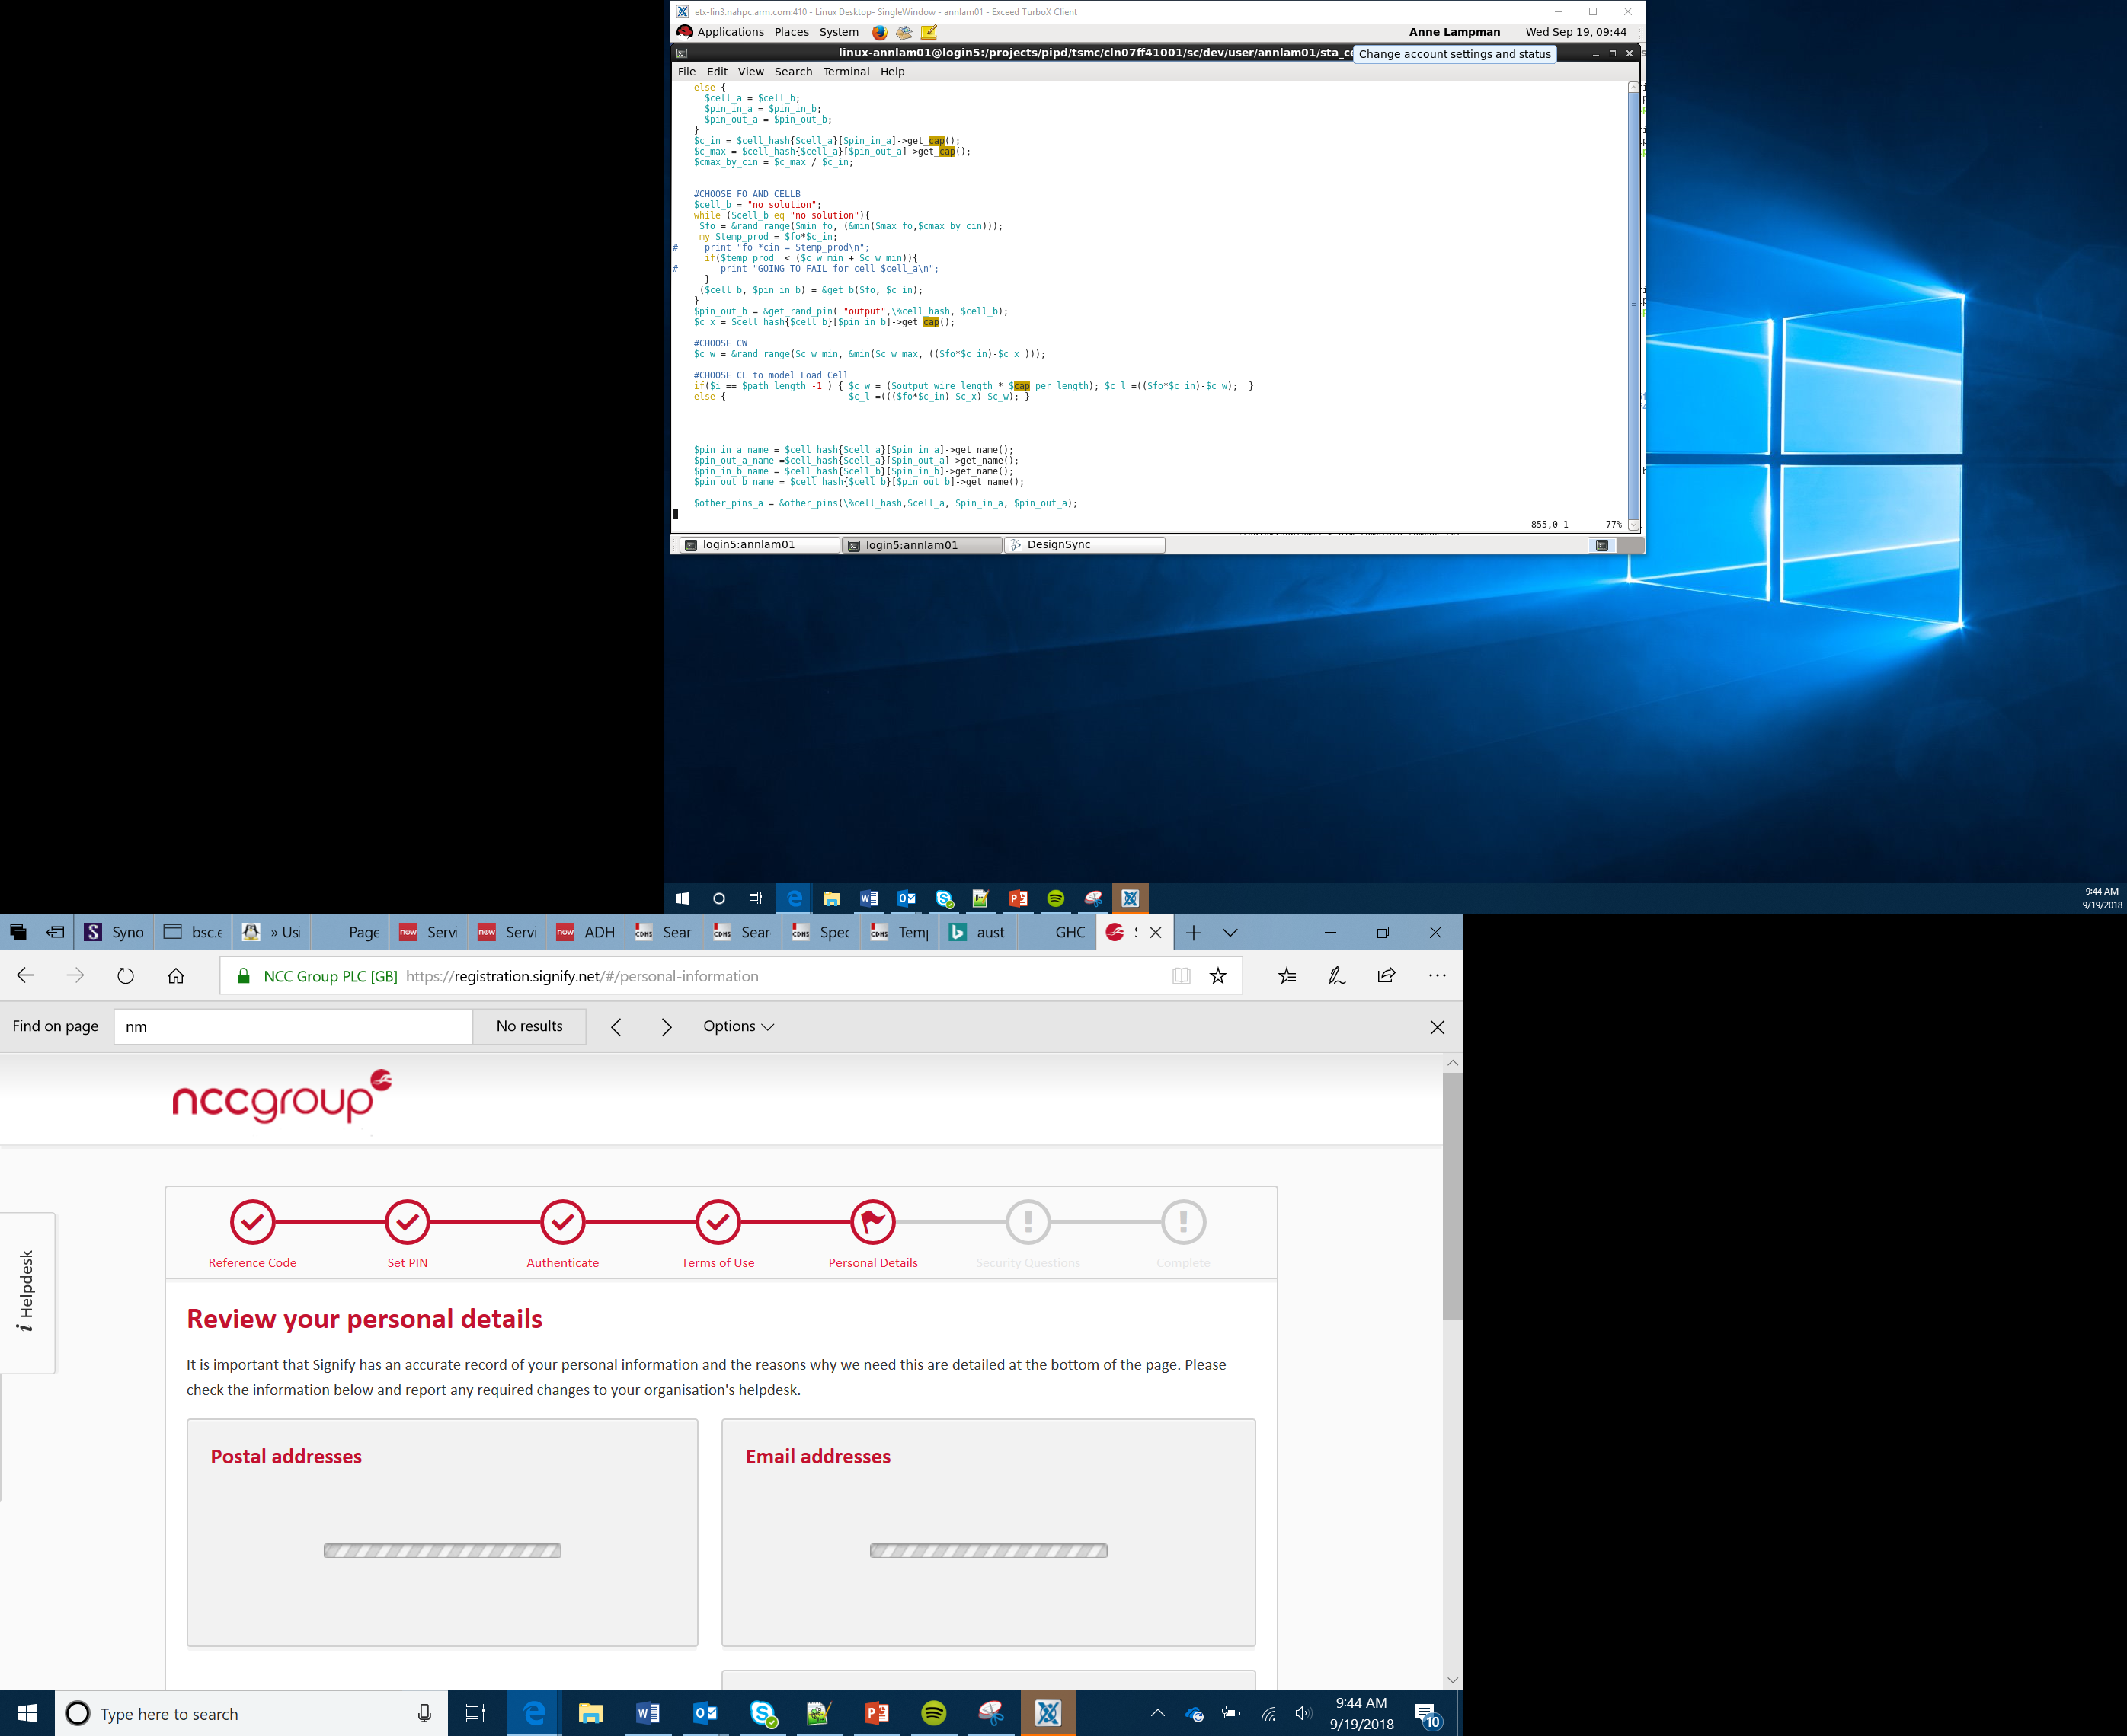

rock:paper: scissors game
Lesson 9

Slide 2

The rock:paper:scissors Game
Today you are going to create a game of rock:paper:scissors
The game will be played on two micro:bits
Radio blocks will be used to send and receive data between the two micro:bits
This Photo by Unknown Author is licensed under CC BY-NC

Slide 3
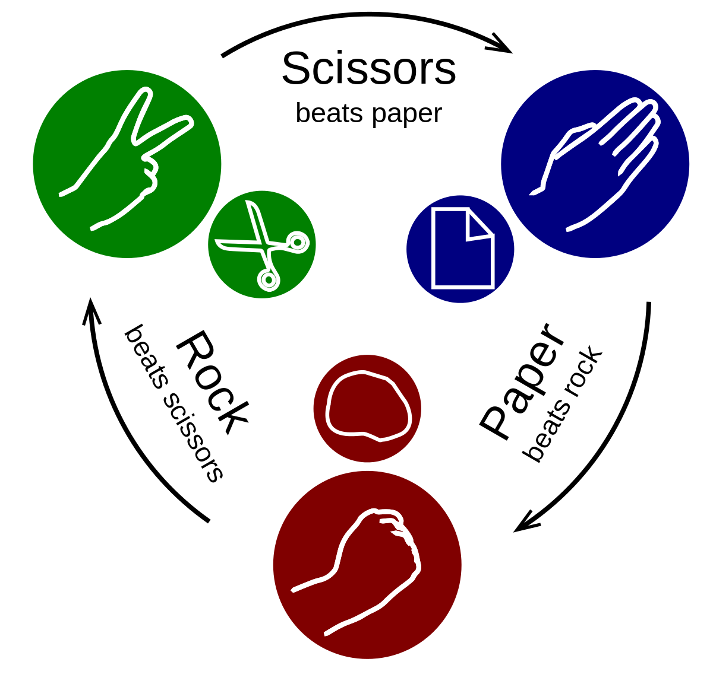
Game Logic
Before starting to develop the game, it is useful to play it
With a partner you will shortly play the game
After the counting to three each player will choose whether they are rock, paper or scissors by making the relevant shape with their hand
The winner will be determined using the rules below:
Scissors cuts paper so scissors wins
Paper wraps rock so paper wins
Rock blunts scissors so rock wins
If both players choose the same object, the game results in a draw
This Photo by Unknown Author is licensed under CC BY-SA

Slide 4
Success Criteria
Make a game where A beats B, B beats C and C beats A
The program will randomly select A, B or C when shaken
The program will transmit the selection via radio, and will determine if it has won or lost the match
The program will keep count of wins and losses until reset by a button press (A and B)

Slide 5

Evaluation
Once you have completed the programming you should then test the game
When you are happy that the game is working as planned you may wish to attempt the Stretch Tasks
This Photo by Unknown Author is licensed under CC BY-NC-ND

